Slide 1

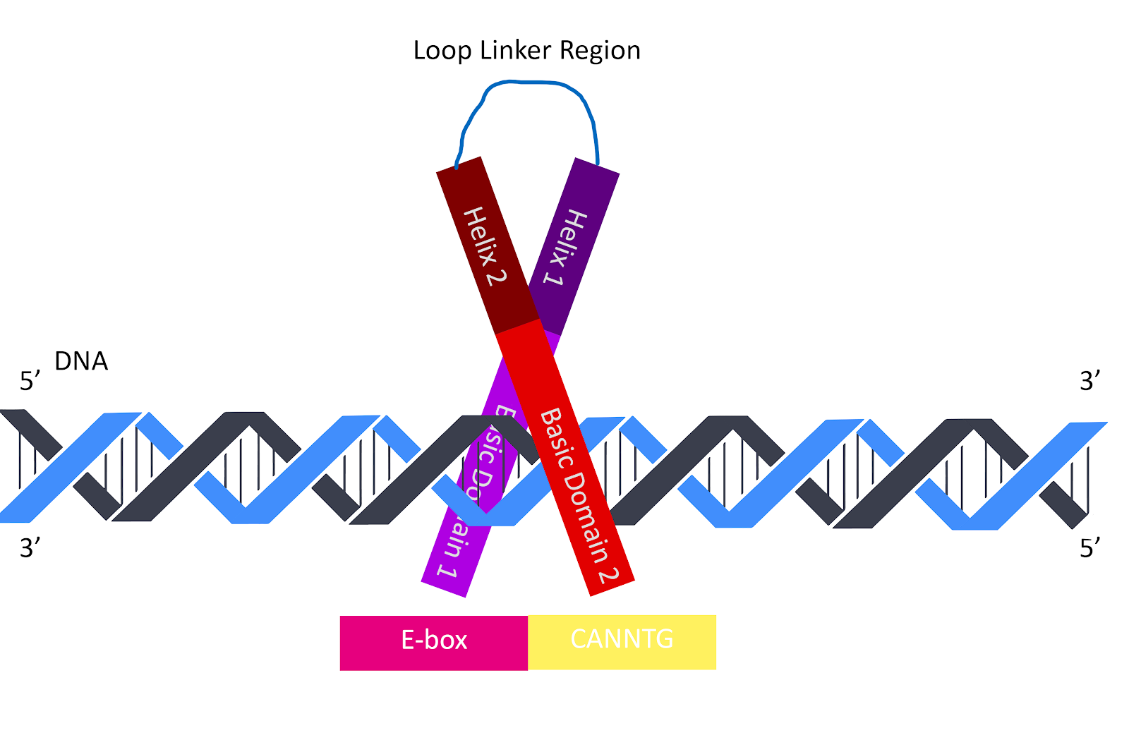
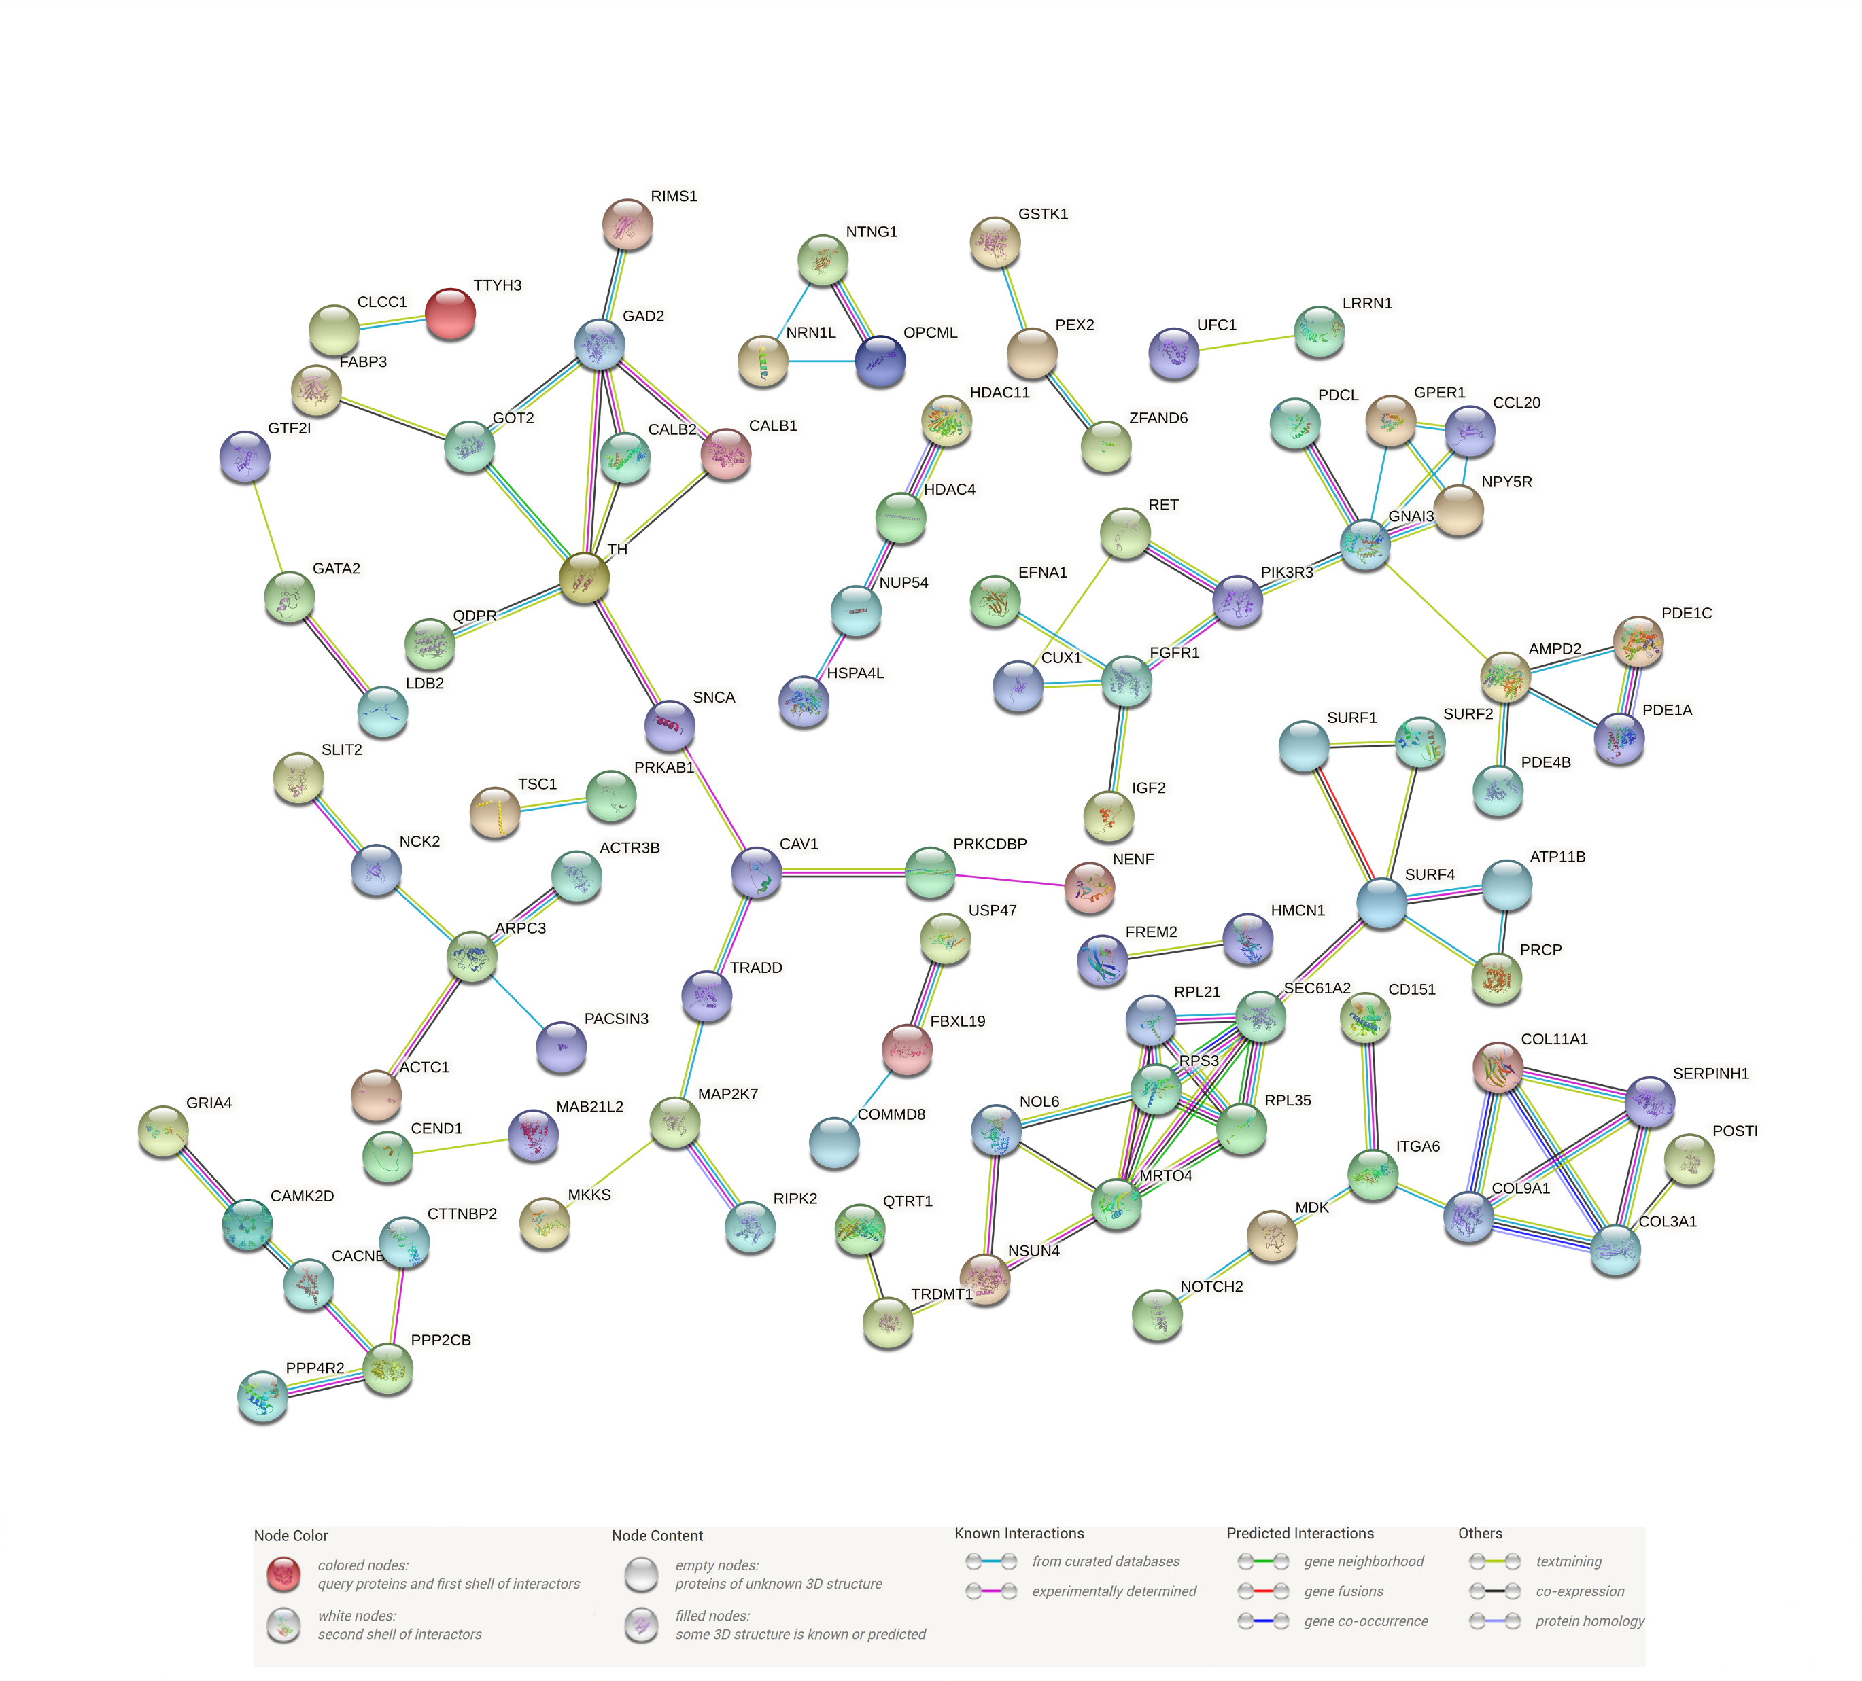

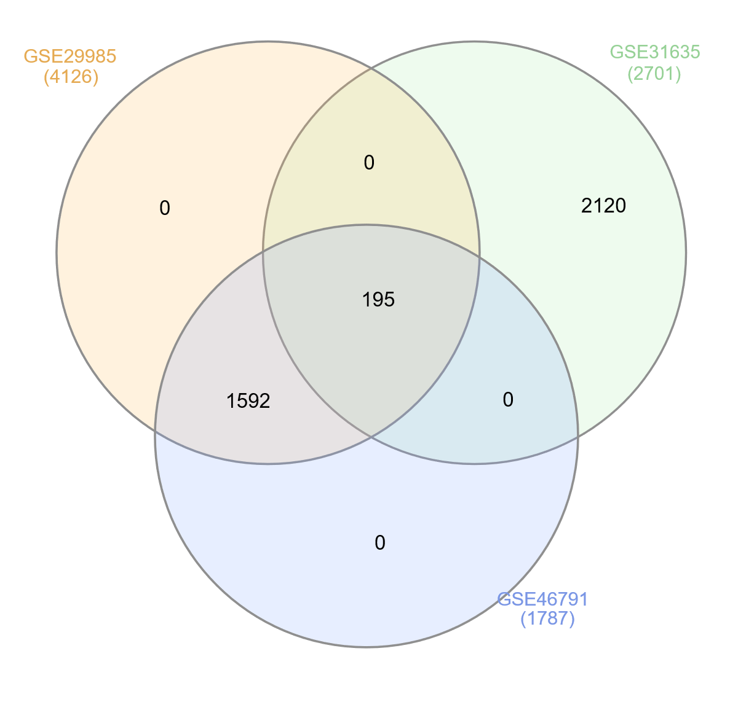
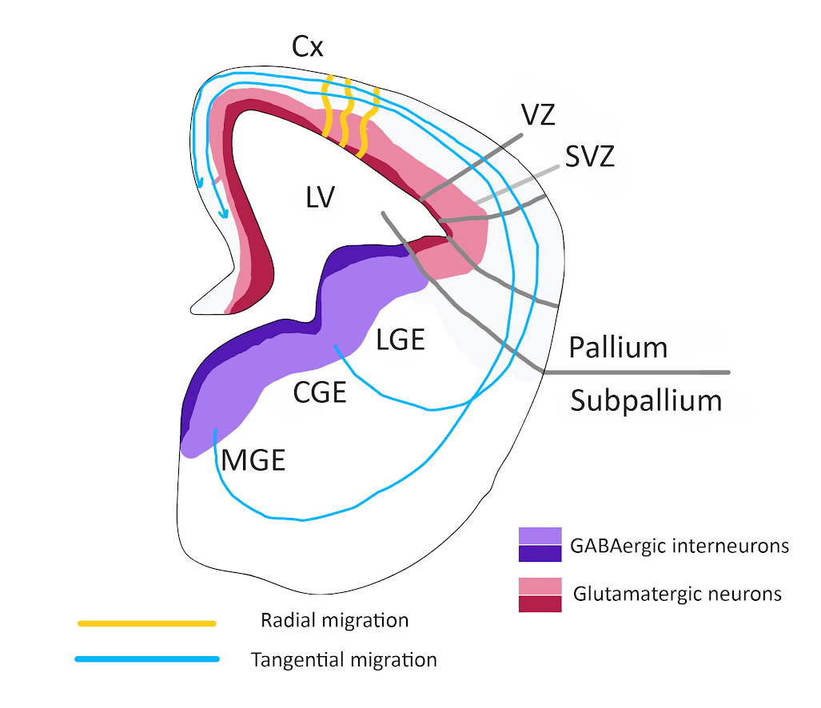
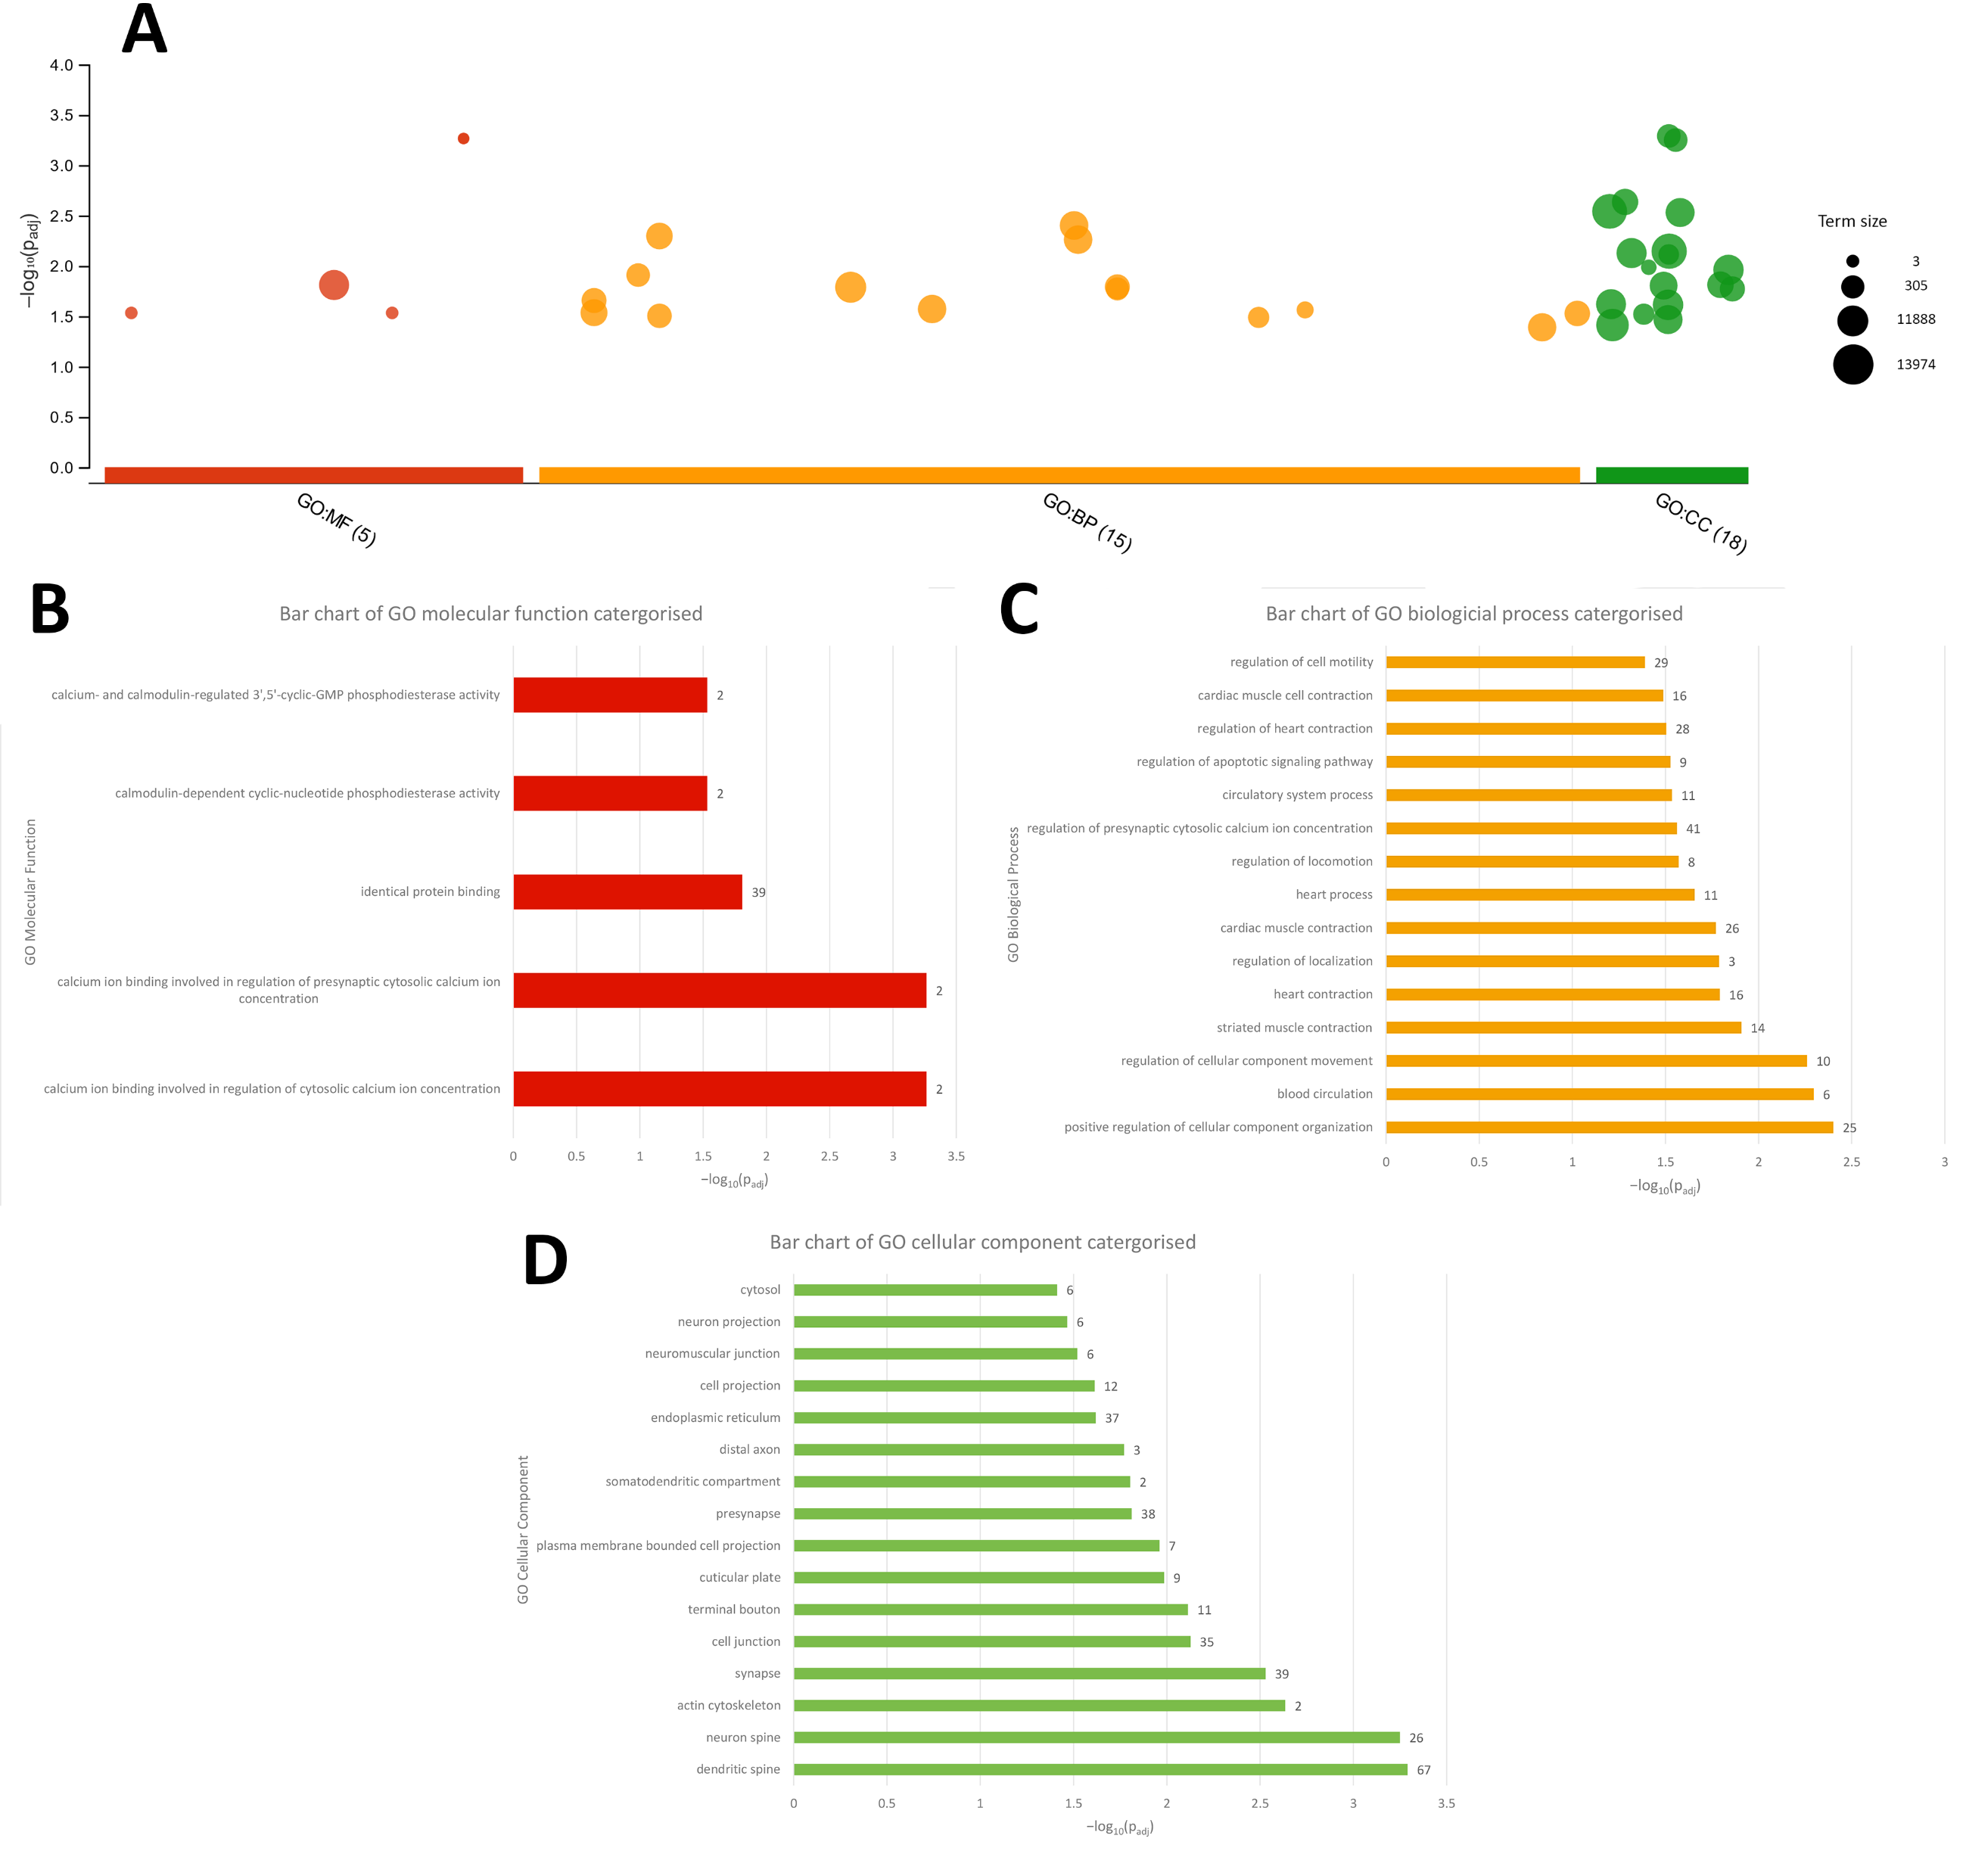
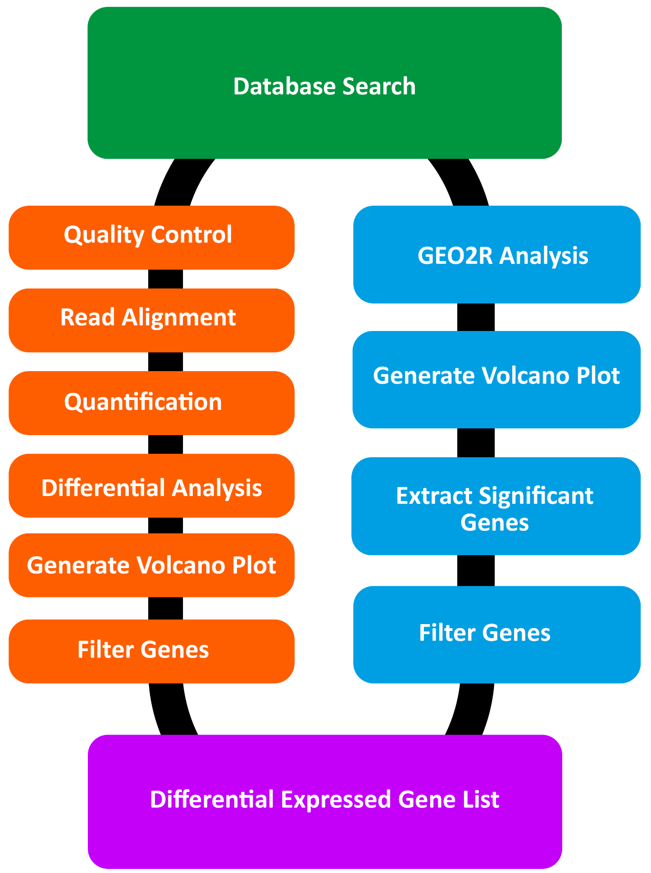
Transcriptional analysis of ASCL1 and the effects of neurogenesis in GABAergic neurons
George Appeah (UP889480); Project Supervisor: Dr Frank Schubert; School of Biological Sciences, University of Portsmouth
Introduction
Results
To observe what gene-gene interactions were present in the list generated from InteractiVenn, STRING was used.
Neurogenesis refers to the process by which undifferentiated neural progenitor stem cells into functional neurons.
Neurogenesis is can be controlled by bHLH proteins. One example of a bHLH protein is ASCL1 which generate inhibitory GABAergic interneurons which are derived from the ventral telencephalon from MGE and CGE regions.
In order to identify which genes from dataset overlap. The merged gene list from datasets: GSE29985, GSE31635, GSE46791.
Figure 1:The bHLH structural motif which contains a basic region joined by the two α-helix, then a short linker loop region and binds to the DNA via E box motif sequence “CANNTG”
GABAergic neurons prevent continuous excitatory firing of neurons.
Mutations in ASCL1 in GABAergic neurons are associated with Schizophrenia with strabismus and epileptic seizures
Figure 6: STRING Analysis of merged genes which contain upregulated and downregulated genes. The minimum required interaction confidence score was set at 0.65. The unconnected proteins are hidden in the network.
Discussion
CALB1 and CALB2 is expressed in GABAergic neurons and from prenatal development to adulthood
GAD2 is co-expressed with CALB1 (48%) and CALB2 (18%)in GABAergic neurons
Slit2 is has a miniscule role in interneuron migration
Figure 2: Diagram of a hemisection of a mouse embryo forebrain
Figure 4: Venn diagrams generated by InteractiVenn. Showing the both all of the upregulated and downregulated genes merge. Displaying the comparison of 3 gene lists: GSE31635, GSE29985 and GSE46791.
Aims
To investigate which the relationship between ASCL1 target genes and gene ontology. A GO term analysis is performed using the same overlapping gene list generated from InteractiVenn.
To understand the role of regulation of ASCL1 within GABAergic neurons
Identify co-expression groups that occur alongside ASCL1
To investigate the role of ASCL1 targets genes by gene ontology
Conclusion
Methods
Databases E-MTAB-4840, GSE78949 had little to no biological relevance
Further research would investigate neurogenesis in adult samples
Additionally explore why Slit2 is expressed weakly in VZ
Table I. Details of the datasets used in the present study and the biological function.
Database | Biological function and meaning
GSE29985 | Observing the ectopic expression of Arx and comparing it to GABAergic neurons
GSE31635 | Comparing to GABAergic precursors and compared interneuron precursors
E-MTAB-4840 | Observing the expression of genes associated in human embryonic brain
GSE78949 | The enrichment of Ascl1, Smad7 and Nr2f1 in ESC to observe GABAergic markers
GSE46791 | Comparing the epigenetic status of NSCs and immature GABAergic neurons
References
Battiste, J., Helms, A., Kim, E., Savage, T., Lagace, D., & Mandyam, C. et al. (2007). Ascl1 defines sequentially generated lineage-restricted neuronal and oligodendrocyte precursor cells in the spinal cord. Development, 134(2), 285-293. doi: 10.1242/dev.02727
Begega, A., Alvarez-Suarez, P., Sampedro-Piquero, P., & Cuesta, M. (2017). Effects of Physical Activity on the Cerebral Networks. Physical Activity And The Aging Brain, 3-11. doi: 10.1016/b978-0-12-805094-1.00001-0
Fish, K., Rocco, B., & Lewis, D. (2018). Laminar Distribution of Subsets of GABAergic Axon Terminals in Human Prefrontal Cortex. Frontiers In Neuroanatomy, 12. doi: 10.3389/fnana.2018.00009
Ide, M., Yamada, K., Toyota, T., Iwayama, Y., Ishitsuka, Y., & Minabe, Y. et al. (2005). Genetic association analyses of PHOX2B and ASCL1 in neuropsychiatric disorders: evidence for association of ASCL1 with Parkinson’s disease. Human Genetics, 117(6), 520-527. doi: 10.1007/s00439-005-1342-8
Jones, S. (2004). An overview of the basic helix-loop-helix proteins. Genome Biology, 5(6), 226. doi: 10.1186/gb-2004-5-6-226
Massari, M., & Murre, C. (2000). Helix-Loop-Helix Proteins: Regulators of Transcription in Eucaryotic Organisms. Molecular And Cellular Biology, 20(2), 429-440. doi: 10.1128/mcb.20.2.429-440.2000
Figure 3: Flow diagram of processing the RNASeq and microarray datasets into differential expressed gene list.
Figure 5: A, GO Term Enrichment analysis visualised as a Manhattan-like-bubble graph. Results of GO enrichment analysis for B, molecular function C, biological process and D, cellular component categories. The X-axis shows the -Log10 of the adjusted P-value. The Y axis represents the GO term associated with in each graph.
Notes:
Hello My Name is George and going give you a presentation of the Transcriptional analysis of ASCL1 and the effect of neurogenesis in GABAergic neurons
Neurogenesis refers to undifferentiated neural progenitor stem cells transforming into functional neurons.
One of way that neurogenesis is controlled by bHLH proteins.
Fig 1. which showed The bHLH structural motif which binds to the DNA via E box motif sequence “CANNTG”
An example of a bHLH protein is ASCL1 which generate GABAergic interneurons which are derived from the ventral telencephalon from medial ganglionic eminence (MGE) and the caudal (CGE) ganglionic eminence regions in the telencephalon.
Fig 2 displays the migration of GABAnergic from the CGE and MGE regions to the cortex via tanginal migration
GABAergic neurons modulate the excitatory transmission of neurons and mutations in ASCL1 in GABAergic neurons are linked to schizophrenia with strabismus and epileptic seizures
In this analysis ill focus on identifying co-expression groups that occur alongside ASCL1 and investigate the role of ASCL1 targets genes by gene ontology and also undetstand role of regulation of ASCL1 in GABAergic neurons using bioinformatics techniques.
So the methods I used aand how they where done is represented in figure 3 Using a database search for RNA seq in Arrayexpress database and microarray sets in the GEO database in which 5 datasets were choosen GSE29985 (Observing the ectopic expression of Arx and comparing it to GABAergic neurons),
GSE31635(GABAergic precursors and compared interneuron precursors)
GSE78949(The enrichment of Ascl1, alongwith and several other factors to observe GABAergic neurons markers
GSE46791 (compared the epigenetic status of neural stem cells (NSCs) and immature GABAergic neruons) and
E-MTAB-4840 (expression of genes associated in human embryonic brain)
. The microarray data undergone (follow the blue) whilst RNA Seq followed (the orange side)
Each five datasets upregulated and downregulated genes were merged and placed into intervenn and the gene overlap was exported to g;profiler and String which looked at visual network between various proteins using various criteria
Likewise for the Go term analysis in Figure 5A displays 36 GO terms divided into molecular function, biological process and cellular component. 17 were associated with cellular components, 14 to biological processes and 5 GO terms were linked to molecular function.
Figure 5B-D. displays the enrichment of genes and the significances of GO term
Finally the STRING analysis in figure 6 which display the protein-protein interactions
And based on the evidence collected I can establish that CALB1 and CALB2 is expressed in GABAergic neurons from throught life and GAD2 is co-expressed in CALB1 and CALB2 in 48% and 18% of neurons respecitvly, Slit2 is has a miniscule role in interneuron migration and Dataset E-MTAB-4840 resulted in few gene overlap
So to conclude what does the future of this area of research show? It that Databases E-MTAB-4840, GSE78949 had little to no biological relevance and therefore futher research would need to investigate neurogenesis using adut brain samples to provide a accurate view of GABAerhgic neurogenesis. And futher research could explore why Slit2 is poor expressed in VZ

